Slide 1


Vince Conca
3/27/2024

Slide 2

Outline
Executive Summary
Introduction
Methodology
Results
Conclusion
Appendix

Slide 3
Executive Summary
Methodology
Data collection
Data wrangling
Exploratory data analysis (EDA)
Dashboard creation
Predictive modeling
Results
Overall success rate for the Falcon 9 was 67% allowing the option to reuse the first stage of the rocket 2 out of every 3 launches.

Slide 4
Introduction
The commercial space age is here, companies are making space travel far more affordable.
One of the most successful is SpaceX. SpaceX’s accomplishments include: Sending spacecraft to the International Space Station. And Starlink, a satellite internet constellation providing satellite Internet access.
SpaceX advertises Falcon 9 rocket launches on its website with a cost of 62 million dollars; other providers cost upwards of 165 million dollars each.
Much of the savings is because SpaceX can reuse the first stage.
Therefore, if we can determine if the first stage will land, we can determine the cost of a launch.
This project aims to predict if the first stage will successfully land and be available for reuse, thus dramatically impacting the cost of a rocket launch.

Slide 5

Section 1

Slide 6
Methodology
Executive Summary
Data collection methodology:
API calls, Web scraping
Perform data wrangling
Broke data down into a relevant features set and a target set of success/failure
Perform exploratory data analysis (EDA) using visualization and SQL
Perform interactive visual analytics using Folium and Plotly Dash
Perform predictive analysis using classification models
Built 4 models, tuning each for optimal parameters, then reviewed accuracy and confusion matrix for each model

Slide 7
Data Collection
Two methods used
SpaceX launch data REST API pulls general data regarding launches. That dataset is combined with multiple other endpoints:
Rocket
Adds specific data pertaining to rocket types
Payload
Adds payload mass and orbit type
Cores
Adds outcome of the landing, type of landing, number of flights, the landing pad used, the block of the core (which is a number used to separate version of cores), number of times this specific core has been reused, and the serial of the core.
Web Scraping from SpaceX Wikipedia

Slide 8
Data Collection – SpaceX API
Parent SpaceX REST call URL: https://api.spacexdata.com/v4
Endpoints used:
/launches/past
/rockets
/launchpads
/payloads
/cores
GitHub URL of completed SpaceX API calls notebook here.
Client
Request
Request
Handler
Response
(json)
Dataframe
Service Handler
Database
Handler

Slide 9
Data Collection - Scraping
Web scraping Falcon 9 and Falcon Heavy Launches Records from Wikipedia.
GitHub URL of completed Web Scraping notebook here.
Use BeautifulSoup Python Package
Find Falcon 9 launch records HTML table
Convert into a Pandas dataframe
Parse the table for information needed

Slide 10
Data Wrangling
Reviewed the launch sites and number of launches per site
Majority (55) took place in Florida at site: CCAFS SLC 40
Reviewed all orbit types and counts for each orbit
GTO was the favored orbit type with 27 launches of that type.
GTO = A geosynchronous orbit is a high Earth orbit that allows satellites to match Earth's rotation
Reviewed launch outcomes
Majority (41) were successfully landed to a drone ship
Overall success rate was 67%
Prepared data for modeling
Created a ‘Class’ column using 1 for success and 0 for fail
GitHub URL of completed Wrangling notebook here.

Slide 11
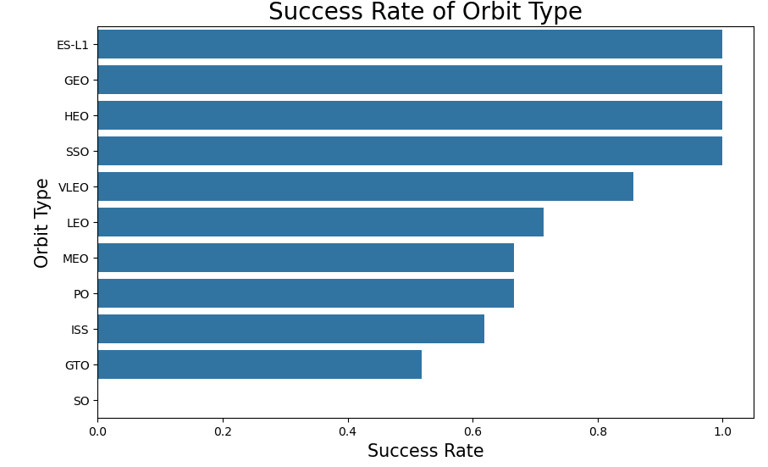
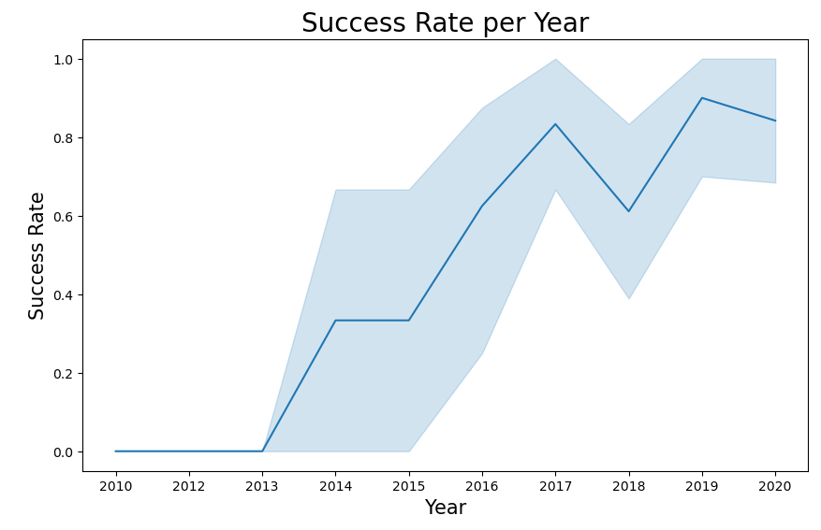
EDA with Data Visualization
Visualizing the Orbit types and launch outcomes over time can be seen below.
The below visualizations can be found within this Github notebook.

Slide 12
EDA with SQL
SQL queries were ran to gather further insights. Some highlights below.
Launch site names
Payload mass carries by boosters launched by NASA
Average payload mass for specific boosters
Date of first successful launch
Total number of successful outcomes
Boosters carrying max payload
Counts of landing outcomes
To see the actual queries and results, plus all other queries, refer to this notebook on Github.

Slide 13
Build an Interactive Map with Folium
Folium was used to plot launch sites and launch outcomes.
Markers and marker clusters were used to identify the criteria.
Launch locations included three in Florida and one in California.
Launch sites were very near the coast and away from major cities.
Distance to Miami was calculated to show the distance of a launch site to a major city.
A line on the map indicates the relationship.
To view the Folium visualizations, a notebook on Github found here can be reviewed.

Slide 14
Build a Dashboard with Plotly Dash
A Dashboard was created allowing a user to select a specific site or all launch sites along with payload masses as these two criteria carried a lot of weight in launch success.
The user could then view the outcomes of launches based on selected criteria.
The dashboard proved useful in viewing which combinations provided the best launch results.
The notebook containing the python code and the python executable file can be found here.

Slide 15
Predictive Analysis (Classification)
Create Features and Target dataframes
Split data into Train and Test datasets
Four models were built: Linear Regression, SVM, Decision Tree, KNN
Each model used a technique to find ideal parameters to train the model.
Predictions were made and accuracy calculated.
Each model was then compared against each other to identify the optimal model.
The notebook on Github can be found here.
Apply technique to find ideal parameters
Select various parameters and create model object
Train model
Make predictions and view accuracy results

Slide 16
Results
The below Results are detailed on the remaining slides
Exploratory data analysis results
Interactive analytics demo in screenshots
Predictive analysis results

Slide 17

Section 2

Slide 18
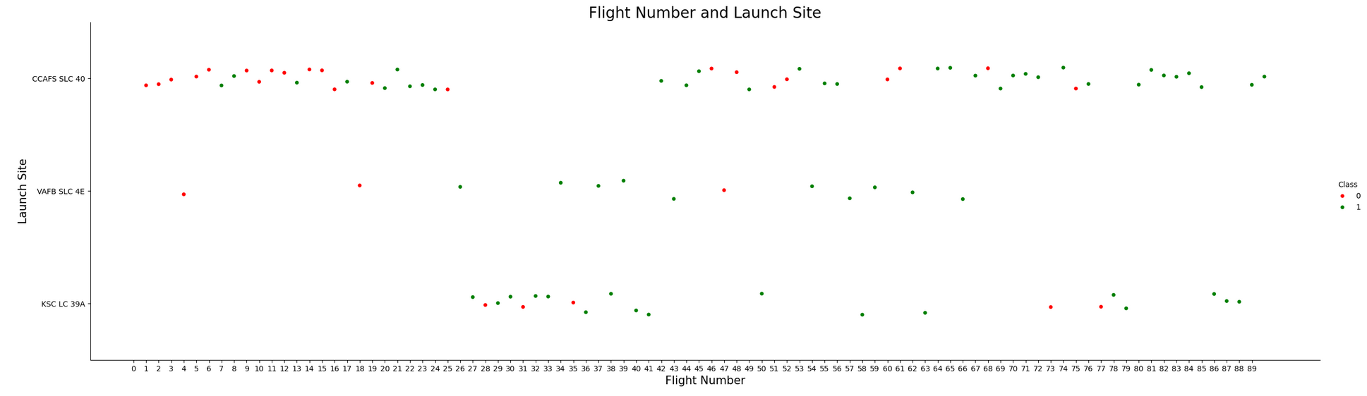
Flight Number vs. Launch Site
0 (red dots) = failed outcomes; 1 (green dots) = successful outcome
As the launches increased, the success rate improved. This also points out the high number of fails for location CCAFS SLC 40 is due to that is the only site with early launches when there was a much higher fail rate.

Slide 19
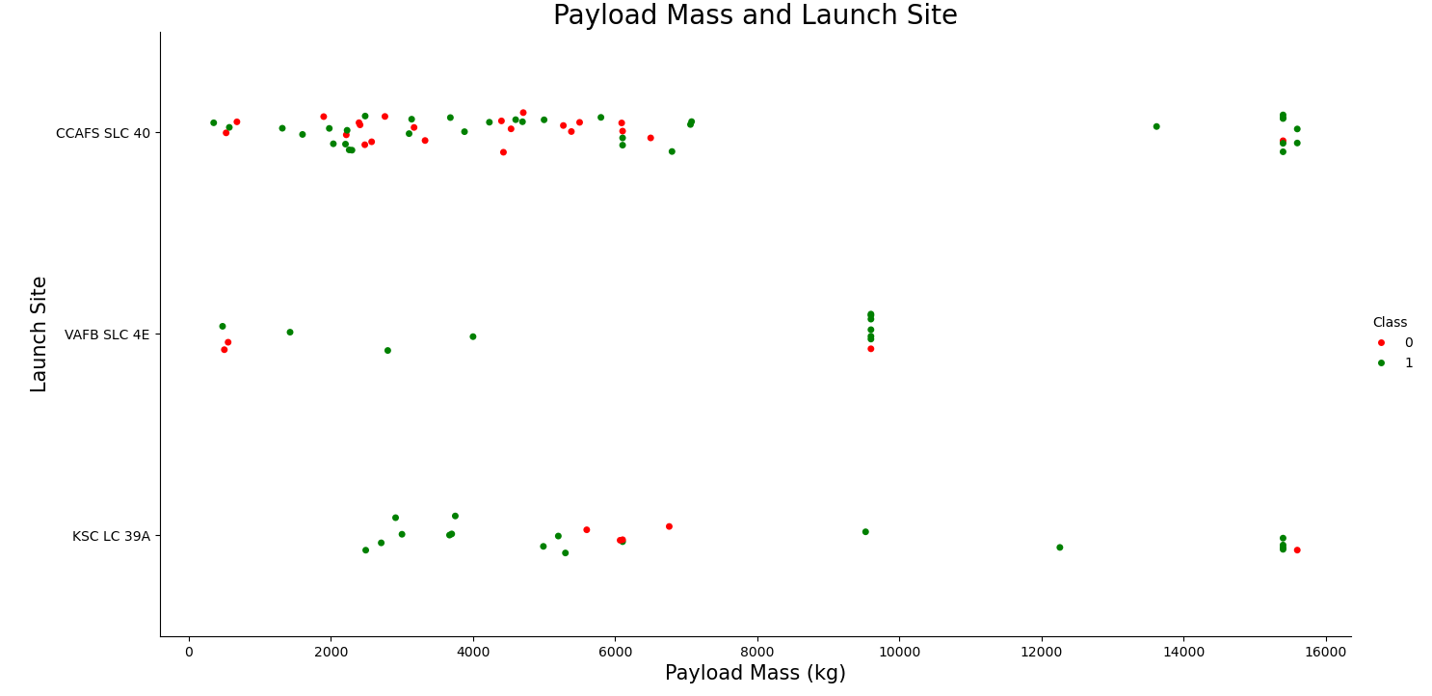
Payload vs. Launch Site
0 (red dots) = failed outcomes
1 (green dots) = successful outcome
Show a scatter plot of Payload vs. Launch Site
All sites held launches with payloads under 10,000kg with varying degrees of success.
Location VAFB SLC 4E did not have any payloads greater than 10,000kg.
Majority of all launches were under 8,000kg payload

Slide 20
Success Rate vs. Orbit Type
Orbit types of ES-L1, GEO, HEO, and SSO had 100% success rates
GTO was the lowest with no orbit types for SO

Slide 21
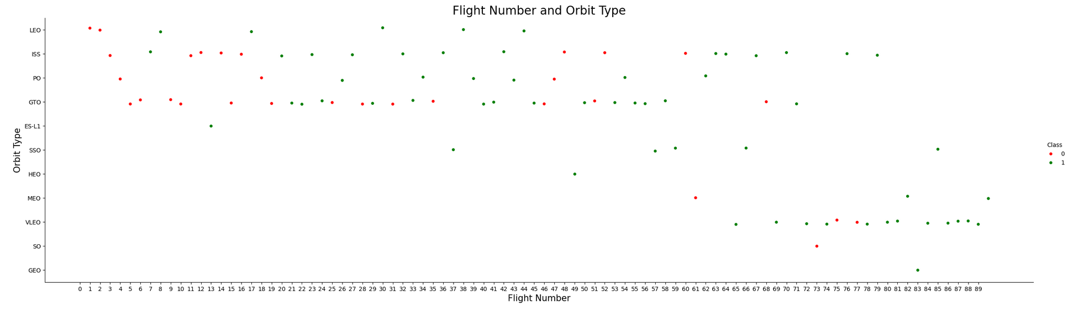
Flight Number vs. Orbit Type
Show a scatter point of Flight number vs. Orbit type
VLEO success is more attributed to it being later flights.
The failure rates of LEO, ISS, PO, and GTO can be more attributed to they were the only orbit types for early flights.
Since orbit types were not consistently tested from start to finish, it’s hard to glean what sort of success or failure can be attributed to orbit type.

Slide 22
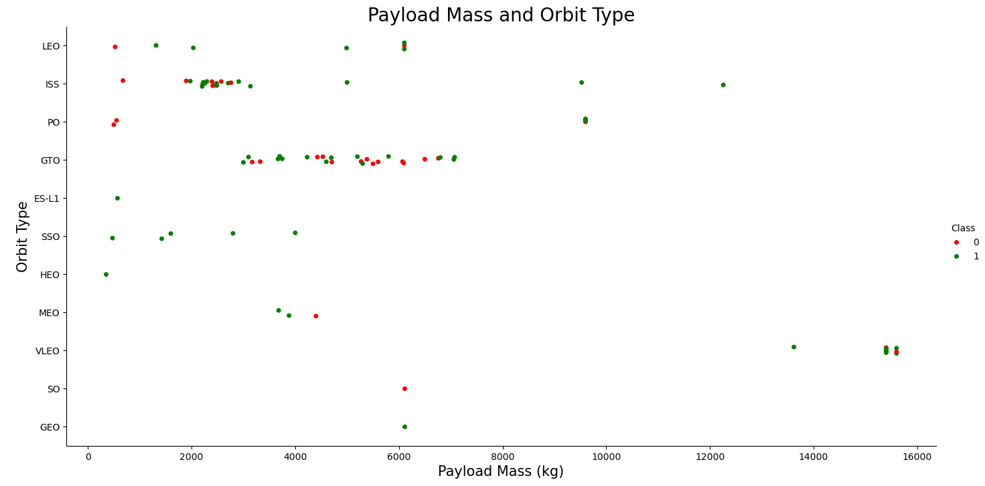
Payload vs. Orbit Type
GTO had many launches, with no clear success, using payload between ~3,000kg and ~7,000kg

Slide 23
Launch Success Yearly Trend
Launch success rate has steadily increased from 2013.
A dip took place in 2018, but recovered to an all time success high in 2019.

Slide 24
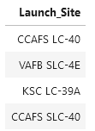
All Launch Site Names
The launch site names are:
CCAFS LC-40
VAFB SLC-4E
KSC LC-39A
CCAFS SLC-40
The SQL query used was:
SELECT DISTINCT "Launch_Site“
FROM SPACEXTABLE;

Slide 25
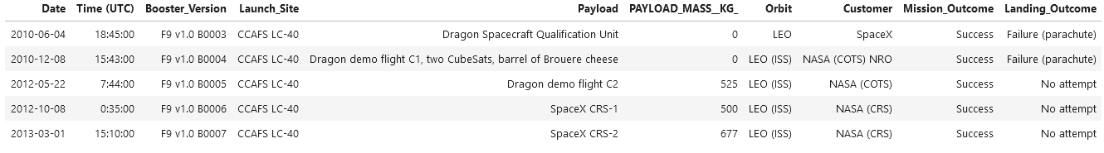
Launch Site Names Begin with 'CCA'
Here are 5 records where launch sites begin with `CCA
The SQL query used was:
SELECT *
FROM SPACEXTABLE
WHERE "Launch_Site" LIKE 'CCA%’
LIMIT 5;

Slide 26
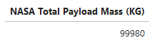
Total Payload Mass
The total payload carried by boosters from NASA
99,980kg
The SQL query used was:
SELECT SUM(PAYLOAD_MASS__KG_) AS 'NASA Total Payload Mass (KG)’
FROM SPACEXTABLE
WHERE Customer LIKE 'NASA%';

Slide 27
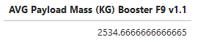
Average Payload Mass by F9 v1.1
The average payload mass carried by booster version F9 v1.1
2,534.67kg
The SQL query used was:
SELECT AVG(PAYLOAD_MASS__KG_) AS 'AVG Payload Mass (KG) Booster F9 v1.1’
FROM SPACEXTABLE
WHERE Booster_Version LIKE 'F9 v1.1%';

Slide 28
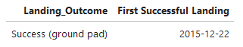
First Successful Ground Landing Date
The date of the first successful landing outcome on ground pad
December 22, 2015
The SQL query used was:
SELECT DISTINCT Landing_Outcome, Date AS 'First Successful Landing’
FROM SPACEXTABLE
WHERE Landing_Outcome = 'Success (ground pad)’
ORDER BY date ASC
LIMIT 1;

Slide 29
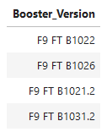
Successful Drone Ship Landing with Payload between 4000 and 6000
The boosters which have successfully landed on drone ship and had payload mass greater than 4000 but less than 6000
F9 FT B1022
F9 FT B1026
F9 FT B1021.2
F9 FT B1031.2
The SQL query used was:
SELECT Booster_Version
FROM SPACEXTABLE
WHERE Landing_Outcome = "Success (drone ship)"
AND PAYLOAD_MASS__KG_ > 4000
AND PAYLOAD_MASS__KG_ < 6000;

Slide 30
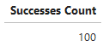
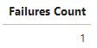
Total Number of Successful and Failure Mission Outcomes
The total number of successful and failure mission outcomes
Successful: 100
Failures: 1
1st SQL query used:
SELECT COUNT(Mission_Outcome) AS 'Successes Count’
FROM SPACEXTABLE
WHERE Mission_Outcome LIKE '%Success%';
2nd SQL query used:
SELECT COUNT(Mission_Outcome) AS 'Failures Count’
FROM SPACEXTABLE
WHERE Mission_Outcome LIKE '%Failure%';a

Slide 31
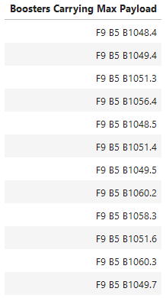
Boosters Carried Maximum Payload
The boosters which have carried the maximum payload mass
F9 B5 B1048.4
F9 B5 B1049.4
F9 B5 B1051.3
F9 B5 B1056.4
F9 B5 B1048.5
F9 B5 B1051.4
F9 B5 B1049.5
F9 B5 B1060.2
F9 B5 B1058.3
F9 B5 B1051.6
F9 B5 B1060.3
F9 B5 B1049.7
The SQL query used was:
SELECT DISTINCT Booster_Version AS 'Boosters Carrying Max Payload’
FROM SPACEXTABLE
WHERE PAYLOAD_MASS__KG_ = (
SELECT MAX(PAYLOAD_MASS__KG_)
FROM SPACEXTABLE);

Slide 32
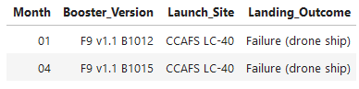
2015 Launch Records
The failed landing outcomes for drone ship, their booster versions, and launch site names for the year 2015
January and April
The SQL query used was:
SELECT substr(Date, 6,2) AS 'Month', Booster_Version, Launch_Site, Landing_Outcome
FROM SPACEXTABLE
WHERE Landing_Outcome = 'Failure (drone ship)'
AND substr(Date, 0, 5) = '2015'

Slide 33
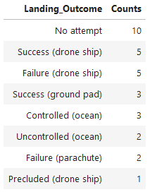
Rank Landing Outcomes Between 2010-06-04 and 2017-03-20
The count of landing outcomes, fail or success, between June 4th, 2010 and March 20th, 2017
Landing_Outcome | Counts
No attempt | 10
Success (drone ship) | 5
Failure (drone ship) | 5
Success (ground pad) | 3
Controlled (ocean) | 3
Uncontrolled (ocean) | 2
Failure (parachute) | 2
Precluded (drone ship) | 1
The SQL query used was:
SELECT Landing_Outcome, COUNT(Landing_Outcome) AS 'Counts’
FROM SPACEXTABLE
WHERE Date BETWEEN '2010-06-04' AND '2017-03-20’
GROUP BY Landing_Outcome
ORDER BY Counts DESC;

Slide 34

Section 3

Slide 35
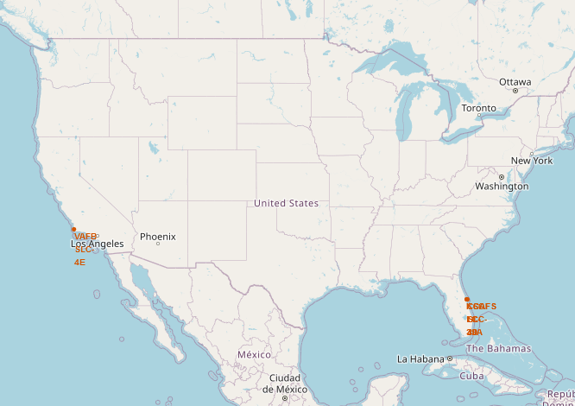
Map of Launch Locations
The 1st Folium map Shows the launch locations on both the west coast (California) and east cost (Florida)

Slide 36
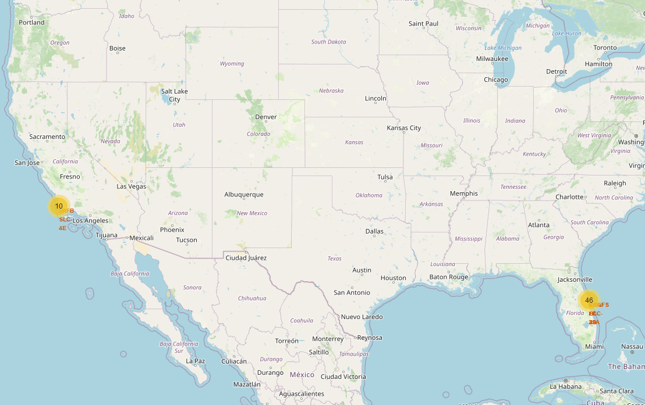
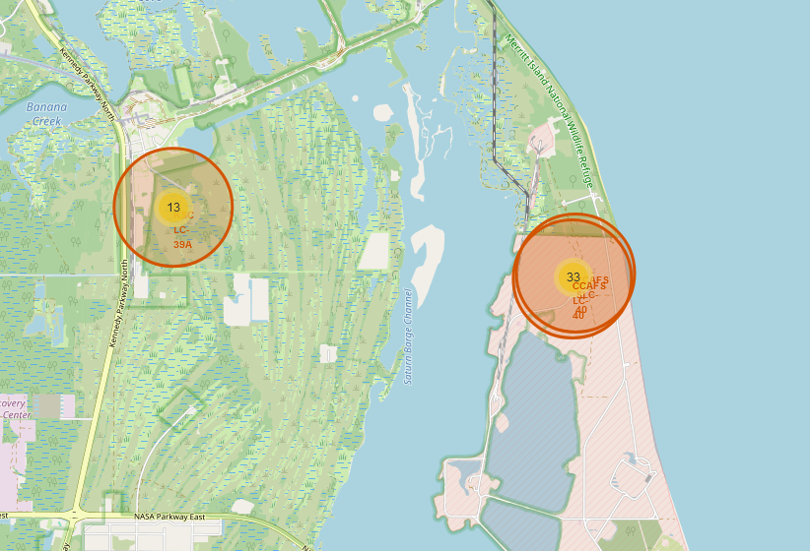
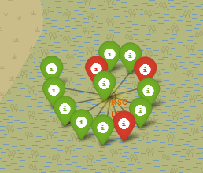
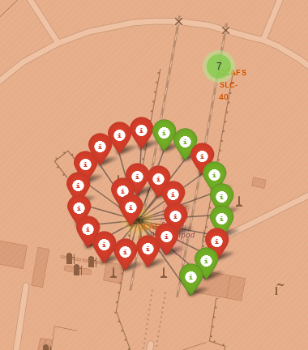
Map with Launch Counts
1
The 2nd map added counts and clusters when zoomed in.
Green = success | Red = fail
Counts of Launches
2
3
Florida zoomed in
Two Florida sites zoomed
In further

Slide 37
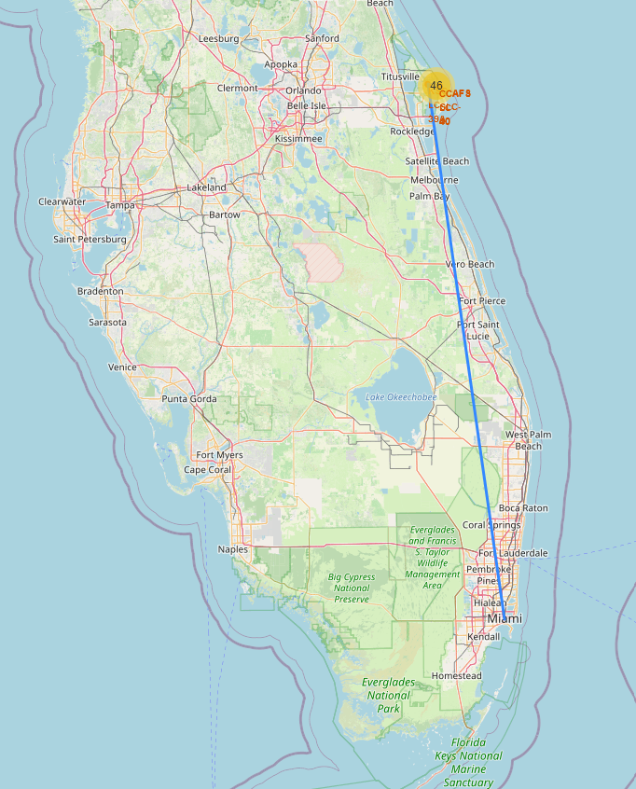
Map of a Launch Site to Miami
The 3rd map added lines to nearby locations.
The example on the map to the right is from launch site KSC LC-39A to Miami.
314.77 miles
Note: Any marker, line, and distance can be added to the map as needed.

Slide 38

Section 4

Slide 39
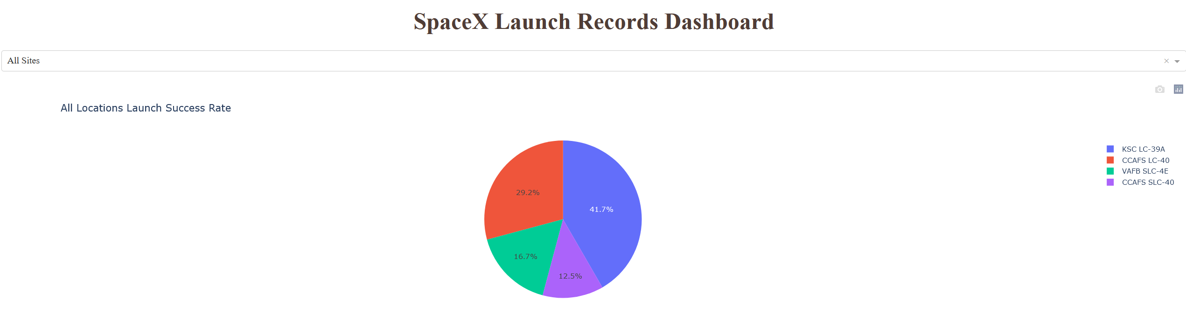
All Launch Site Success Rate
The launch location with the highest success rate is KSC LC-39A
with a 41.7% success rate

Slide 40
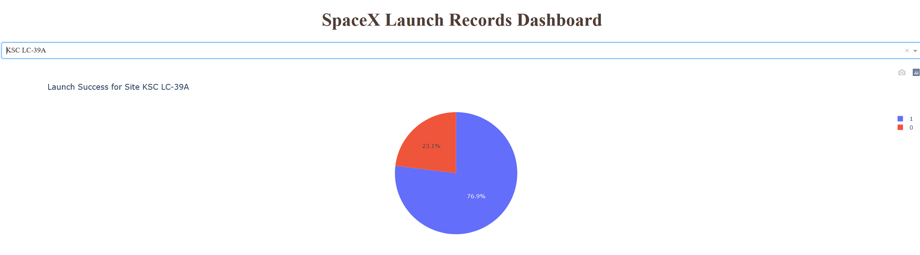
KSC LC-39A Launch Success Rate
Focusing in on KSC LC-39A, we see the success rate
of just that site is 76.9%

Slide 41
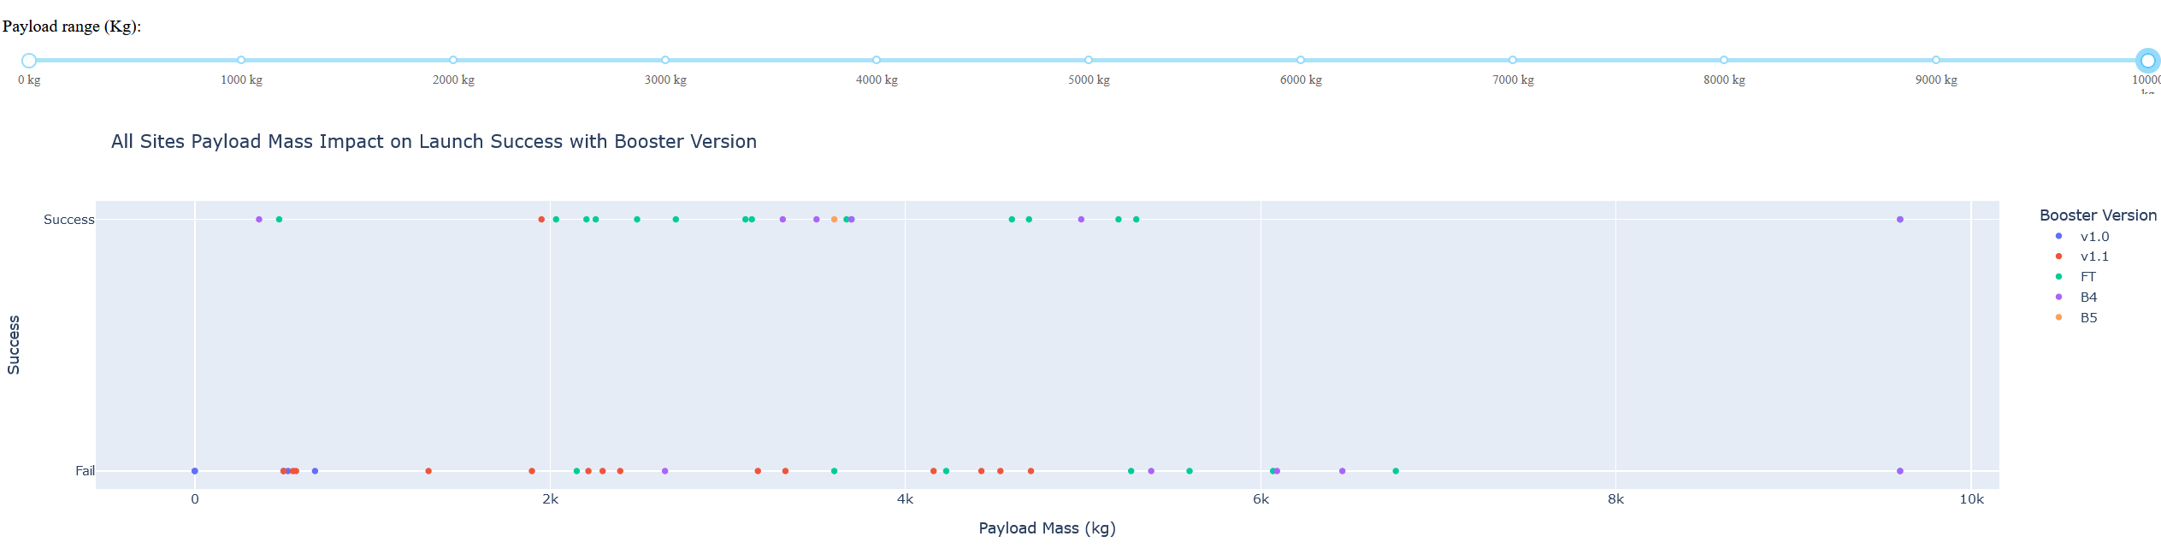
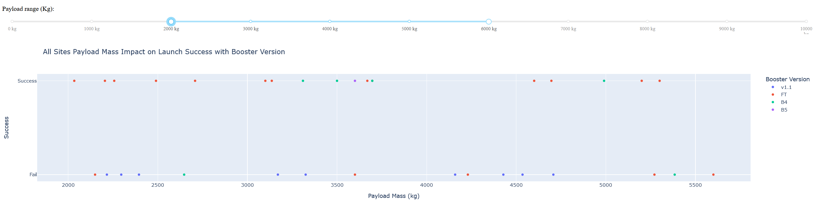
Payload Slider with Successes and Failures
All Sites; payload slider set to full (0kg to 10,000kg)
Most successes are between 2,000kg and 6,000kg
All Sites; payload slider set to range (2,000kg to 6,000kg)

Slide 42

Section 5

Slide 43
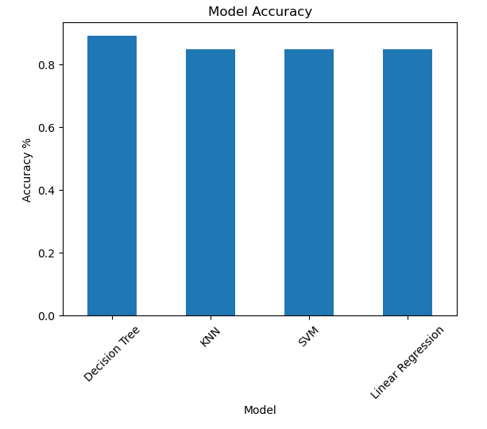
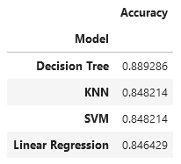
Classification Accuracy
Of the 4 models built, trained, and tested, the Decision Tree model proved the best.

Slide 44
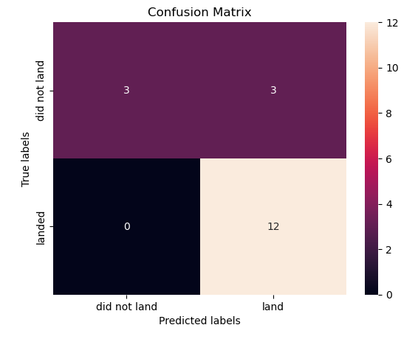
Confusion Matrix
The Decision Tree Confusion Matrix shows we had 12 successful landings and 6 failed landings.
The Decision Tree predicted 15 successes and 3 failures, so 3 true fails were mislabeled as successes, or in other words, the model had 3 false positives.
This is the model that performed the best, however it was not by a wide margin.

Slide 45
Conclusions
All Launch Sites have a high success rate
Payload mass seems to have minimal impact on success rate
Orbit type appeared to have an impact, however it was more due to later launches were of a different orbit type and later launches were simply more successful
More than anything, time and experience is what appears to have the greatest impact on success rate. The visualizations, dashboard, and models all indicated a varying degree of success with the various variables and they all improved over time as the number of launches increased. By 100 launches, SpaceX seems got it pretty well figured out, however since they did not test everything equally throughout all 100 launches, it made it a little difficult to discern what led to better results.
Overall success rate for the Falcon 9 was 67% allowing the option to reuse the rocket 2 out of every 3 launches.

Slide 46
Appendix
All Jupyter Notebooks, source files, the Dashboard, and presentation can be found at the Github repository found here.

Slide 47


